Slide 1
ISTQB
Introduction
Notes:
Tener en cuenta que esta capacitación cubre únicamente los aspectos mas importantes de la certificación, el estudio de esta capacitación no asegura la aprobación de la misma, se debe estudiar por completo el material oficial.

Slide 2
ISTQB
International Software Testing Qualifications Board
La certificación mas reconocida a nivel mundial, relacionada directamente con software testing
Material Oficial: istqb_foundation_level_syllabus_2011.pdf

Slide 3
Benefits
For professionals:
International recognition
Higher appeal in the labor market
For companies:
Companies with certified staff can offer higher-level services to customers.
Competitive advantage for companies
Notes:
ENGEE busca ser una empresa con toda el area de QA certificado.
International recognition of acquired competencies and skills
Mayor atractivo en el mercado laboral
Consulting companies with certified staff can offer higher-level services to customers.
ISTQB® certification can provide a competitive advantage for companies, promising a higher level of reliability of the applications being developed due to efficient and cost effective testing practices derived from the ISTQB® competencies

Slide 4
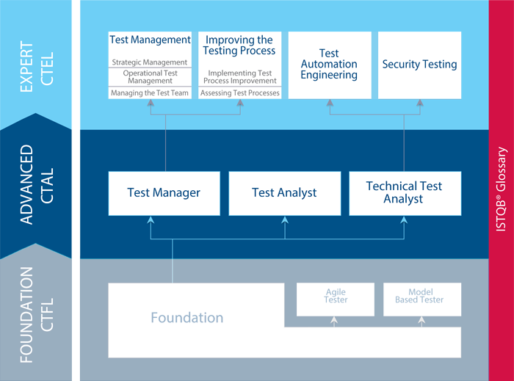
Certifications
Notes:
Agile tester extension
Model-Based Tester extension
Advanced Level
Expert Level

Slide 5
Testing objectives
Finding defects
Gaining confidence about the level of quality
Providing information for decision-making
Preventing defects

Slide 6
7 Testing Principles
Testing shows presence of defects
Exhaustive testing is impossible
Early testing
Defect clustering
Pesticide paradox
Testing is context dependent
Absence of errors fallacy
Notes:
1.Testing shows presence of defects: Testing can show the defects are present, but cannot prove that there are no defects.
2.Exhaystive testing is impossible: Testing everything including all combinations of inputs and preconditions is not possible.
3. Early testing: In the software development life cycle testing activities should start as early as possible and should be focused on defined objectives.
4. Defet clustering: A small number of modules contains most of the defects discovered during pre-release testing or shows the most operational failures.
5. Pesticide paradox: If the same kinds of tests are repeated again and again, eventually the same set of test cases will no longer be able to find any new bugs.
6. Testing is context dependent : Different kinds of sites are tested differently.
7. Absense of errors fallancy: If the system built is unusable and does not fulfil the user’s needs and expectations then finding and fixing defects does not help.

Slide 7
Test process
Test planning and control
Test analysis and design
Test implementation and execution
Evaluating exit criteria and reporting
Test closure activities
Notes:
Test planning and control : is the activity of defining the objetives of testing and the specification of test activities in order to meet the objetives and mission.
Test analysis and design : Is the activity during wich general testing objetives are transformed into tangible test conditions and test cases.
Test implementation and execution
evaluating exit criteria and reporting
Test closure activities

Slide 8
Level of independence in software testing
Tests by the person who wrote the item
Tests by another person within the same team
Tests by the person from some different group
Tests by a person from a different organization or company
MORE independence MORE effective
Notes:
There is several level of independence in software testing which is listed here from the lowest level of independence to the highest: i. Tests by the person who wrote the item. ii. Tests by another person within the same team, like another programmer. iii. Tests by the person from some different group such as an independent test team. iv. Tests by a person from a different organization or company, such as outsourced testing or certification by an external body.
This degree of independence avoids author bias and is often more effective at finding defects and failures.

Slide 9
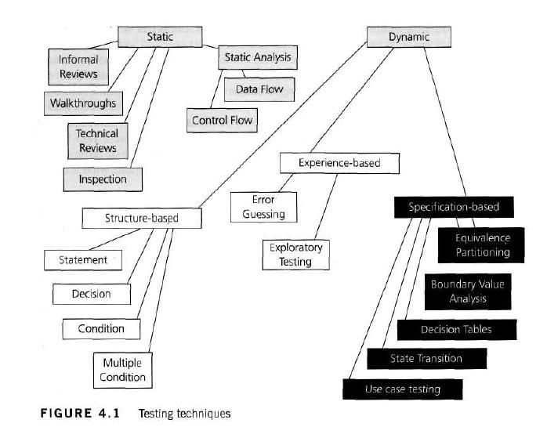
Static vs. Dynamic

Slide 10
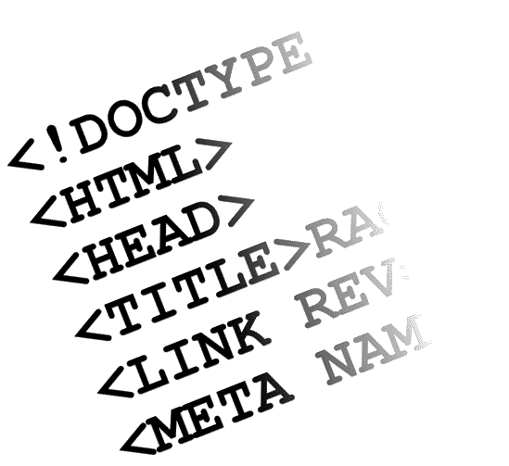
Static Techniques
Static testing: It can test and find defects without executing code.
Advantages:
Early detection of defects prior to test execution
Identification of defects not easily found by dynamic testing
Prevention of defects
Notes:
Static testing: It can test and find defects without executing code. Static Testing is done during verification process. For example: reviewing, walkthrough, inspection, etc.
Dynamic Testing: In dynamic testing the software code is executed to demonstrate the result of running tests

Slide 11
Static Techniques
Informal review: Are not documented
Formal review:
Planning
Kick-off (optional)
Preparation
Review meeting (Examination/evaluation/recording of results)
Rework
Follow Up
Notes:
Static testing: It can test and find defects without executing code. Static Testing is done during verification process. For example: reviewing, walkthrough, inspection, etc.
Planning: Defining the review criteria
selecting the personnel
Allocating roles
Defining the entry and exit criteria for more formal reviews types
Selecting which parts of documens to review
Checking entry criteria
2. Kick-off: distributing documents
Explaining the objetives, process and documents to the participants.
3. Individual preparation
Preparing for the review meeting by reviewing the document
Noting potencial defects, question and comments
4. Examination/evaluation/recording of results (review meeting)
Discussing or logging, with documented results or minutes
Noting defects, making recommendations regarding handling the defects, making decisons about the defects
Examining/evaluating and recording issues during any physical meetings or tracking any group electronic communications
5. Rework
Fixing defects found (typically done by the author)
Recording updated status of defects (in formal reviews)
6. Follow up
Checking that defects have been addressed
Gathering metrics
Checking on exit criteria

Slide 12
Formal review - Types
Walkthrough
Technical Review (peer review)
Inspection
Static analysis
Notes:
Walkthrough: Not formal process. Lead by the author. Author guide the participants through the document
Technical Review: Less formal review. Led by a trained moderator or technical expert. Defect are foind by the expert
Inspection: Most formal review. Lead by trained moderators. It helps the author to improve the quality of the document under inspection
Static analysis: Performed on requirement design or code without actually executing the software or before the code is actually run.

Slide 13
Dynamic Testing
Dynamic Testing: the software code is executed
Specification-based
Structure-based
Experience- based
Notes:
specification-based (black-box, also known as behavioral techniques). Include both functional and nonfunctional techniques
structure-based (white-box or glass box or structural techniques): the testers require knowledge of how the software is implemented, how it works.
experience- based: The experience of both technical and business people is required, as they bring different perspectives to the test analysis and design process.

Slide 14
Specification-based or Black Box
Specification-based
Equivalence partitioning
Boundary value analysis
Decision tables
State transition testing
Notes:
Equivalence partitioning (EP): The idea behind this technique is to divide a set of test conditions into groups or sets that can be considered the same, hence ‘equivalence partitioning’. Equivalence partitions are also known as equivalence classes. We need to test only one condition from each partition
Boundary value analysis (BVA): is based on testing at the boundaries between partitions. we have both valid boundaries (in the valid partitions) and invalid boundaries (in the invalid partitions).
Decision tables: is a good way to deal with combinations of things (e.g. inputs). This technique is sometimes also referred to as a ’cause-effect’ table.
State transition testing: This simply means that the system can be in a (finite) number of different states, and the transitions from one state to another are determined by the rules of the ‘machine’.

Slide 15
Dynamic Testing – Experience based
Experience-based
Error Guessing
Exploratory Testing
Notes:
Error Guessing: used after more formal techniques have been applied to some extent, can be very effective. The success of error guessing is very much dependent on the skill of the tester. In using more formal techniques, the tester is likely to gain a better understanding of the system, what it does and how it works.
Exploratori Testing: is a hands-on approach in which testers are involved in minimum planning and maximum test execution.

Slide 16
Causes of Software Defects
A human being can make an error MISTAKE, wich produces a defect FAULT/BUG, in the program code, o in a document. If a defect in code is executed, the system may fail to do what it should do, causing a FAILURE
Failure: visible to end-users
Bug Cycle: Open, Assigned, Fixed, Closed.
Notes:
Defect: The bugs introduced by programmer inside the code are known as a defect. This can happen because of some programatical mistakes.
Failure: If under certain circumstances these defects get executed by the tester during the testing then it results into the failure which is known as software failure.
Not all defects result in failures, some may stay inactive in the code and we may never notice them. Example: Defects in dead code will never result in failures.

Slide 17
Cost of defects
Notes:
Earlier the defect is found lesser is the cost of defect

Slide 18
Software Testing Levels
Unit testing
Component testing (or Module testing)
Integration testing
Component integration testing
System integration testing
System testing
Acceptance testing
Alpha testing
Beta Testing
Notes:
Unit testing: It is basically done by the developers to make sure that their code is working fine and meet the user specifications.
Component testing: It is also called as module testing.
Component testing plays a very important role in finding the bugs. Before we start with the integration testing it’s always preferable to do the component testing in order to ensure that each component of an application is working effectively.
Integration testing: Integration testing is done when two modules are integrated, in order to test the behavior and functionality of both the modules after integration. Below are few types of integration testing:
Component integration testing: In the example above when both the modules or components are integrated then the testing done is called as Component integration testing.
System integration testing: System integration testing (SIT) is a testing where testers basically test that in the same environment all the related systems should maintain data integrity and can operate in coordination with other systems.
System testing: In system testing the testers basically test the compatibility of the application with the system.
Acceptance testing: Acceptance testing are basically done to ensure that the requirements of the specification are met.
Alpha testing: Alpha testing is done at the developers site. It is done at the end of the development process.
Beta testing: Beta testing is done at the customers site. It is done just before the launch of the product.

Slide 19
Unit testing
Method: White box
When?: Before integration testing
By whom?: By developers
Advantages:
Issues are found at early stage
Unit testing helps in maintaining and changing the code
Unit testing helps in simplifying the debugging process

Slide 20
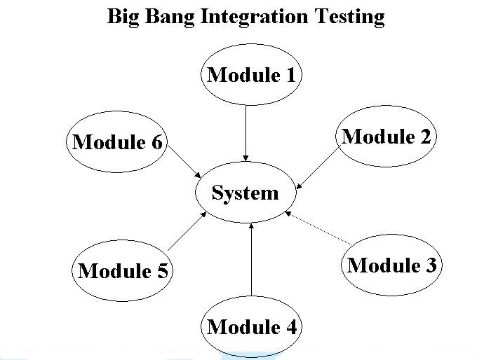
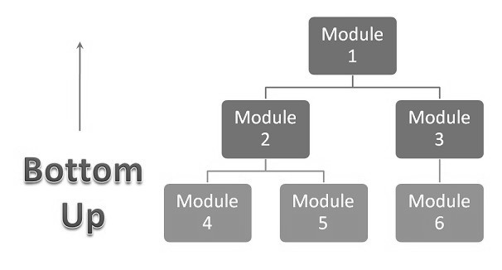
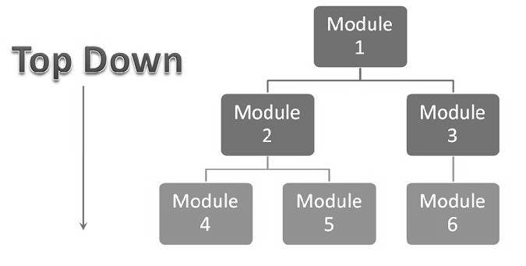
Integration Testing - Types
Big Bang
Top Down
Botton Up
Incremental Testing
Notes:
Integration testing: Integration testing is done when two modules are integrated, in order to test the behavior and functionality of both the modules after integration. Below are few types of integration testing:
Big bang integration testing
In Big Bang integration testing all components or modules are integrated simultaneously, after which everything is tested as a whole.
Ventajas: Big Bang testing has the advantage that everything is finished before integration testing starts.
Desventaja: The major disadvantage is that in general it is time consuming and difficult to trace the cause of failures because of this late integration.
Top down: Testing takes place from top to bottom, following the control flow or architectural structure.
Desventaja Basic functionality is tested at the end of cycle:
Bottom up: Testing takes place from the bottom of the control flow upwards. Components or systems are substituted by drivers.
Desventaja: we can catch the Key interface defects at the end of cycle
is required to create the test drivers for modules at all levels except the top control
Incremental Testing: Integration and testing takes place on the basis of the functions and functionalities, as documented in the functional specification.

Slide 21
System testing
Is concerned with the behavior of a whole system/product
Should investigate functional and non-functional requirements of the system, and data quality characteristics.
An independent test team often carries out system testing
Notes:
Is concerned with the behavior of a whole system/product. The testing scope shall be clearly addressed in the master and/or level test plan for that test level.
In system testing, the test environment should correspond to the final targeo or production environment as much as possible in order to minimize the risk of environment-especific failures not being found in testing.
System testing may include tests based on risks and/or on requrements specifications, business processes, use cases, or other hight level text descriptions or models of system behavior, onteractions with the operating syste, and system resources.
System testing should investigate functional and non-functional requirements of the system, and data quality characteristics.
An independent test team often carries out system testing

Slide 22
Acceptance Testing
Done to ensure that the requirements of the specification are met.
Done by the user or customer
Notes:
Acceptance testing: Acceptance testing are basically done to ensure that the requirements of the specification are met.
After the system test has corrected all or most defects, the system will be delivered to the user or customer for acceptance testing.
Acceptance testing is basically done by the user or customer although other stakeholders may be involved as well.

Slide 23
Alpha Testing Vs. Beta Testing
Alpha Testing
Who?: User/Customers or an independent tet team
Where?: Developoer´s site
When?: At the end of the development process
Beta Testing:
Who?: Real Users
Where?: Customer site
When?: Just before the launch of the product

Slide 24
Regression testing
Detect these ‘unexpected side-effects’
Verify that modifications in the software or the environment have not caused any unintended adverse side effects
The system still meets its requirements.

Slide 25
Maintenance testing
Once a system is deployed it is in service
testing the changes
regression tests to prove that the rest of the system has not been affected by the maintenance work.

Slide 26
Test Types
Functional Testing
Non-functional testing
Structural testing
Notes:
Functional testing: In functional testing basically the testing of the functions of component or system is done. It refers to activities that verify a specific action or function of the code.
Non-functional testing: (usability testing). Testing quality attributes of the system including performance and usability
Structural testing: Structural testing is often referred to as ‘white box’ or ‘glass box’ or ‘clear-box testing’ because in structural testing we are interested in what is happening ‘inside the system/application’.

Slide 27
Functional Testing
Requirement-based testing:
the requirements are prioritized depending on the risk criteria
Business-process-based testing:
the scenarios involved in the day-to-day business use of the system are described.
Notes:
Functional testing: In functional testing basically the testing of the functions of component or system is done. It refers to activities that verify a specific action or function of the code.

Slide 28
Non-Functional Testing - Types
Testing quality attributes of the system:
Usability testing
Efficiency testing
Maintainability testing
Portability testing
Load testing
Performance testing
Scalability Testing
Stress testing
Volume testing
Notes:
Performance testing tools are basically for system level testing, to see whether or not the system will stand up to a high volume of usage.
load testing is tocheck that the system can handle its expected number of transactions.
volume testing is basically to check that the system can handle a large amount of data, e.g. many fields in a record, many records in a file, etc.
A stress testing is one that goes beyond the normal expected usage of the system (to see what would happen outside its design expectations), with respect to load or volume.

Slide 29
Structural testing or White Box -Types
Statement coverage
Decision coverage (or Branch or All-edges Coverage)
Condition coverage
Notes:
Statement coverage: (Pasar por cada línea de código. https://www.youtube.com/watch?v=9PSrhH2gtkU). In this process each and every line of code needs to be checked and executed. The statement coverage covers only the true conditions.
Decision coverage (or Branch Coverage or All-edges): https://www.youtube.com/watch?v=ZnPmJd5aqyw It covers both the true and false conditions unlikely the statement coverage.
Condition coverage: Condition coverage reports the true or false outcome of each condition. Measures the conditions independently of each other.

Slide 30
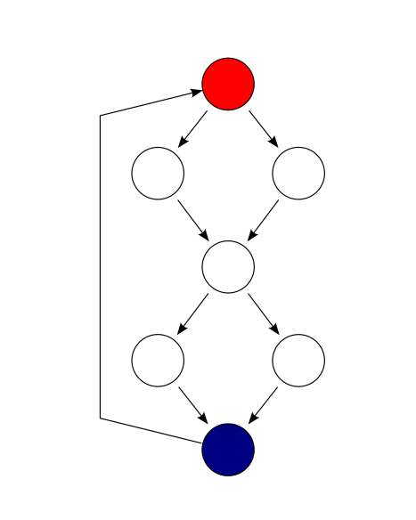
Statement coverage
Statement coverage
1 READ X 2 READ Y 3 Z =X + 2*Y 4 IF Z> 50 THEN 5 PRINT large Z 6 ENDIF
Test 1_1: X= 2, Y = 3 (lines 1 to 4 and line 6.) Test 1_2: X =0, Y = 25 (lines 1 to 4 and line 6.) Test 1_3: X =47, Y = 1(lines 1 to 4 and line 6.)
Test 1_4: X = 20, Y = 25 (100%)
Notes:
Statement coverage: (Pasar por cada línea de código. https://www.youtube.com/watch?v=9PSrhH2gtkU). In this process each and every line of code needs to be checked and executed. The statement coverage covers only the true conditions.

Slide 31
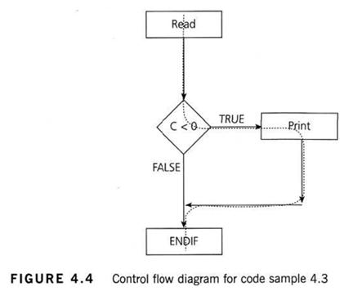
Decision/Branch Coverage
Decision/Branch Coverage
1 READ A 2 READ B 3 C = A – 2 *B 4 IFC <0THEN 5 PRINT “C negative” 6 ENDIF
Test 2_1: A = 20, B = 15. (Only true) Test 2_2: A = 10, B = 2 (Only False)
Decision coverage is stronger than statement coverage. 100% decision coverge guarantees 100% statement coverage, but not vice versa.
Notes:
Decision coverage (or Branch Coverage or All-edges): https://www.youtube.com/watch?v=ZnPmJd5aqyw It covers both the true and false conditions unlikely the statement coverage.

Slide 32
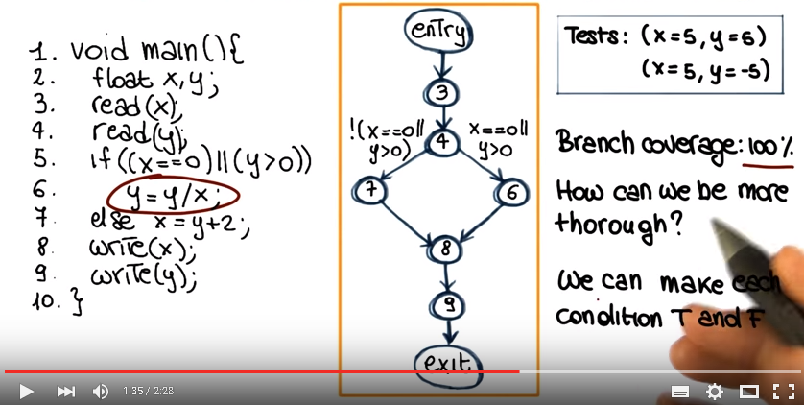
Condition coverage
Condition coverage reports the true or false outcome of each condition. Measures the conditions independently of each other.
Notes:
Condition coverage: Condition coverage reports the true or false outcome of each condition. Measures the conditions independently of each other.
Condition Coverage: https://www.youtube.com/watch?v=ZnPmJd5aqyw

Slide 33
Roles and responsabilities
Test Leader:
Planning
Monitoring
Control
Tester
Identifying test conditions
Design
Execute
Log the test
Notes:
Test Leader: tend to be involved in the planning, monitoring, and control of the testing activities and tasks.
Test monitoring: Give the test team and the test manager feedback on how the testing work is going, allowing opportunities to guide and improve the testing and the project. Measure the status of the testing, test coverage and test items against the exit criteria to determine whether the test work is done.
Test Control: is about guiding and corrective actions to try to achieve the best possible outcome for the project.
Tester: Primary people identifying test conditions and creating test designs, test cases, test procedure specifications and test data, and may automate or help to automate the tests. Execute and log the tests, evaluate the results and document problems found.

Slide 34
Software testing RISK
It is a potential problem
Types:
Product risk (or Quality risk)
Project risk
Actions to take:
Mitigate
Contingency
Transfer
Ignore
Notes:
Product risk (or quality risk): (factors relating to what is produced by the work, i.e. the thing we are testing).
Project risk (factors relating to the way the work is carried out, i.e. the test project). Risk such as the late delivery of the test items to the test team or availability issues with the test environment.

Slide 35
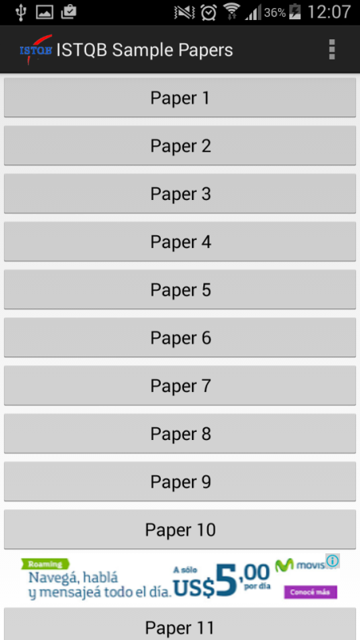
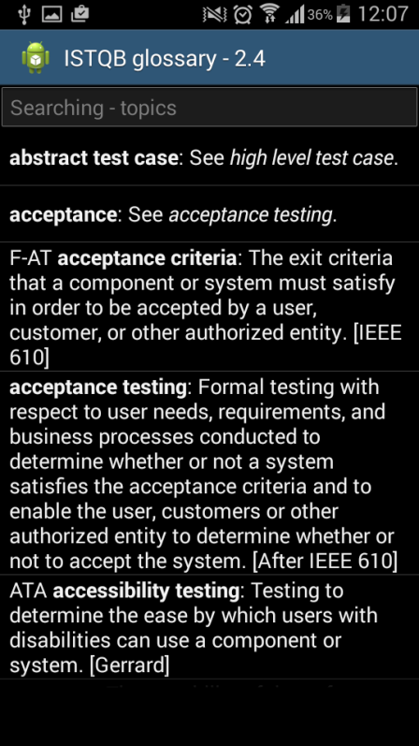
App to practice
Android Apps
ISTQB Glossary
ISTQB Sample Papers
Test Competence
Notes:
Tener en cuenta que los modelos de exámenes no son 100% similares a los reales, la aprobación de los modelos no asegura la obtención de l certificación

Slide 36
Foundation Level exam structure
Number of questions per K levels
K1 – Remember | K2 – Understand | K3 - Apply | K4 - Analyze | Total
20 | 12 | 8 |  | 40
Number of questions per Chapter
Ch. 1 | Ch. 2 | Ch. 3 | Ch. 4 | Ch. 5 | Ch. 6 | Total
7 | 6 | 3 | 12 | 8 | 4 | 40
Notes:
Cantidad de preguntas por capitulo.
Cantidad de preguntas por codigo de estudio.

Slide 38
Exercise 1
Which is not true about the black box tester?
Should be able to understand a functional specification or requirements document
Should be able to understand the source code
Is highly motivated to find faults
Is creative to find the system weaknesses
Notes:
B

Slide 39
Exercise 2
Which of the following is NOT a type of non-functional test?
State-Transition
Usability
Performance
Security
Notes:
A

Slide 40
Exercise 3
Acceptance test cases are based on what?
Requirements
Desing
Code
Decision table
Notes:
A

Slide 41
Exercise 4
Which of the following are not a valid objetives for testing?
To find defects.
To gain confidence in the level of quality
To identify the cause of defects.
To prevent defects.
Notes:
C

Slide 42
Exercise 5
Given the following code, which is the minimum number of test cases required for full statement and branch coverage?
Read P
Read Q
IF P+Q > 100 THEN
Print Large
ENDIF
If P > 50 THEN
Print P Large
ENDIF
Notes:
1 TC 2 BC

